Slide 1




SMART INDIA HACKATHON 2026
Problem Statement ID SIH26045
Problem Statement Title IP-SAKTI (Multilingual RAG-Based Ayurveda IPR Assistant)
Theme Healthcare & Traditional Knowledge
PS Category Software Category
Team ID [Insert Team ID]
Team Name VedaVanguard

Slide 2




SMART INDIA HACKATHON 2026
IDEA TITLE: IP-SAKTI Assistant
Proposed Solution A multilingual RAG-powered AYUSH IPR assistant acting as a digital shield against biopiracy and an intelligent compliance automation platform.
Detailed Explanation Voice/text I/O in 9 Indian languages, 4-step Formulation Classifier (Classical, Proprietary, Phytopharma, Cosmetics), and step-by-step ABS Engine (PIC → MAT → NBA).
Addressing the Problem Mitigates 2,000+ biopiracy risks, navigates overlapping legal regimes (Patents Act Sec 3(p), BDA 2002, TKDL, TRIPS), and removes language barriers for 50K+ AYUSH MSMEs.
Innovation & Uniqueness Strict Jurisdiction Isolation preventing domestic vs. international legal conflation, verifiable statutory citations, and direct expert escalation to legal registries.
@SIH Idea submission - Template
Slide 2
Team: VedaVanguard

Slide 3
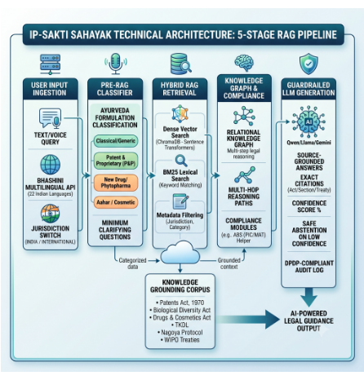
SMART INDIA HACKATHON 2026
TECHNICAL APPROACH: 5-Stage RAG Pipeline
Technologies Used Bhashini Multilingual API & Groq Whisper (Speech), ChromaDB & all-MiniLM-L12-v2 (Vector Embeddings), FastAPI backend, and Gemini/Groq LLMs.
Query & Pre-RAG Ingestion Dual voice/text query ingestion across 9+ Indian languages with smart language detection and active India vs. International jurisdiction routing.
Hybrid Retrieval Engine Dense semantic vector search blended with BM25 lexical keyword matching, merged via Reciprocal Rank Fusion (RRF) over curated government statutes.
Grounded Generation & Guardrails Mandatory statute/section citations, confidence scoring, safe abstention on ambiguity, and DPDP-compliant verifiable audit logs.
@SIH Idea submission - Template
Slide 3
Team: VedaVanguard

Slide 4




SMART INDIA HACKATHON 2026
FEASIBILITY AND VIABILITY
Zero Research Risk
Ultra-Low Infrastructure Cost
Built entirely on mature, proven open-source technologies (FastAPI, ChromaDB, HuggingFace Sentence-Transformers, Groq/Gemini). Working functional MVP is already developed, enabling full production rollout within 6 to 8 weeks.
CPU-optimized lightweight embeddings (~$30/month cloud run on standard serverless instances). Requires zero dedicated GPU clusters, keeping ongoing maintenance exceptionally economical for widespread public deployment.
Potential Challenges & Risks
Mitigation & Legal Safeguards
Complex legal interpretation risks and LLM hallucination on sensitive statutory inquiries, alongside potential conflation between domestic Indian biodiversity acts and foreign patent frameworks.
Strict architectural Jurisdiction Isolation separating domestic acts from international treaties, accompanied by hard prompt guardrails that enforce mandatory legal citations and automated fallback abstention.
@SIH Idea submission - Template
Slide 4
Team: VedaVanguard

Slide 5



SMART INDIA HACKATHON 2026
IMPACT AND BENEFITS
Social Impact
Economic Benefits
Environmental Impact
Democratizing Legal Access: Bridges linguistic divide across 9 Indian regional languages for traditional vaidyas and folk healers.
Slashes Filing Costs: Eliminates steep preliminary attorney consultation fees for early-stage herbal formulations and innovations.
Sustainable Bio-Sourcing: Embeds Biological Diversity Act (BDA 2002) compliance directly into raw herb procurement workflows.
Sovereign Biopiracy Shield: Protects indigenous knowledge holders from unauthorized commercial exploitation and foreign patent poaching.
Prevents Costly Litigation: Pre-empts international opposition proceedings by verifying Section 3(p) prior art upfront.
Traceable ABS Fair Share: Automates compliance records for benefit sharing with local Biodiversity Management Committees (BMCs).
Export Acceleration: Fast-tracks commercial clearances under Nagoya Protocol and Access and Benefit Sharing (ABS) mandates.
Conservation Auditing: Promotes fair ecological trade and conservation of endangered medicinal species.
Grassroots Literacy: Cultivates widespread IPR awareness across 50,000+ AYUSH MSMEs.
@SIH Idea submission - Template
Slide 5
Team: VedaVanguard

Slide 6

SMART INDIA HACKATHON 2026
RESEARCH AND REFERENCES
The Patents Act, 1970 (Section 3(p))
The Biological Diversity Act, 2002 & ABS Rules
Statutory exclusions prohibiting patents on traditional knowledge, non-patentable subject matter, and aggregation of known properties.
National Biodiversity Authority (NBA) guidelines on Prior Informed Consent (PIC), Mutually Agreed Terms (MAT), and benefit-sharing mechanisms.
Traditional Knowledge Digital Library (TKDL)
TRIPS Agreement & The Nagoya Protocol
Pioneering Indian database mapping classical Ayurvedic formulations (Charaka, Sushruta Samhitas) to international patent classification.
International legal frameworks on access to genetic resources, cross-border biopiracy prevention, and equitable benefit-sharing.
WIPO GRATK Treaty (2024 Updates)
Ayurvedic Pharmacopoeia of India (API)
World Intellectual Property Organization treaty mandating disclosure of origin for genetic resources and associated traditional knowledge.
Official pharmacopoeial monographs, classical drug standardizations, and permissible regulatory classification pathways.
@SIH Idea submission - Template
Slide 6
Team: VedaVanguard

